Slide 1
Wisconsin Family Medicine Chief Resident Leadership Course
© Dept of Family and Community Medicine
Medical College of Wisconsin

Slide 2
Teaching & Mentoring
Communicating
SUPPORT & CHALLENGE
Objectives: Learn and Apply
Jeff Morzinski PhD, Professor
Dept of Family and Community Medicine
Medical College of Wisconsin

Slide 3
Support & Challenge Model “The most effective mentors…
High
Challenge
Low
Support
High
*Adopted from Daloz LA, Mentor: Guiding the Journey of Adult Learners, 1999, Jossey-Bass Publishers
Notes:
Mention the “simplicity” of this model… but that it requires practice to become a useful tool.

Slide 4
… Are Able to Balance High Levels of Support and Challenge
Transformation
High
Challenge
Low
Support
High
Notes:
Let’s walk through these quadrants with a common situation in mind:
Let’s say you’re on a specialty rotation that you really care about.
Your preceptor is consistently in the HIGH challenge / LOW support / upper left…
They’re critical and demanding – you feel pushed, rushed.
WHAT would that be like? STRESSFUL… WHAT would you do? RETREAT
Next, imagine your preceptor is uninvolved… that would be LOW and LOW…. STASIS
Next, what if your preceptor provides HIGH support but LOW challenge = CONFIRMATION… “feel good about yourself”
Finally, when your preceptor provides HIGH support and HIGH challenge = GROWTH / TRANSFORMATION is likely.

Slide 5
Relationships & Clinic Staff
You are “Dr Smith”, a new chief resident at a program in Wisconsin.
Two weeks into the academic year, Dr Joe, a new intern, asks you (Dr. Smith) how to build better relations with residency clinic nursing staff…
Dr Joe says “I’ve had a few interactions” with clinic nurses and “I’m not feeling the love”.
Notes:
Next let’s use this model in an example that might occur in your clinic.
Check “is this a fairly common sort of problem…”? Likely that it is.

Slide 6
Relationships & Clinic Staff: What to say to Dr. Joe…?
High
Challenge
Low
Support
High
*Adopted from Daloz LA, Effective teaching and mentoring.
Notes:
As you think about what to say to Dr. Joe… consider these quadrants. You have the choice to respond in several different ways.
Let’s consider examples. Tell me where in the model these examples seem to fit:
“What? – most people seem to like you, especially on donut day.”,
“Your messing up man…our PD is tight with the nurses and when he hears this he will come after you.”
“Same thing happened to me… and you are taking a very positive step – trying to nip this in the bud”.

Slide 7
What to say to Dr. Joe…
“What? – most people seem to like you, especially on donut day.”
High
Challenge
Low
Support
High
Notes:
Chief resident responds in RED on this slide.
The group may think this is “support”
Explain – not really – more like nonsense. Low/Low

Slide 8
What to tell Dr. Joe…
“Your messing up man…our PD is tight with our nurses. When she hears this – and she will hear this – she will come find you, so you better be ready.”
High
Challenge
Low
Support
High
Notes:
Residents REALLY caught on with this example – saw it as VERY high challenge.
“Your messing up man…our PD is tight with the nurses. When he hears – and he will hear this – he will come find you.” This comment provides a few bits of contextual information and an urgent warning.

Slide 9
What to tell Dr. Joe…
“Similar thing happened to me… You are taking a positive step – trying to nip this in the bud”
High
Challenge
Low
Support
High
Notes:
Most residents agree that this is the start of a high support… poised for something to be challenging. I said “yes… maybe a pertinent question – which / depending / could be challenging”.
“Similar thing happened to me… and you are taking a very positive step – trying to nip this in the bud”. Starts with supportive sharing – then acknowledgement that this effort is a good step.

Slide 10
Support & Challenge Themes / Examples
Support
Information, Safe space, Structure, Ask & listen, Hands-on help, Comfort
Challenge
Self-evaluate, Feedback, Discuss, Help set tasks / high expectations / deadlines
Notes:
As we work through how you might respond to Dr Joe…
Here are some examples and themes within these two types of interaction.
Note the overlap: Why is that important?
NEXT… lets discuss your ideas about what you’d say – specifically – to Dr Joe.

Slide 11
Pair up, or just take a Minute
What would YOU say to Dr Joe?
One or two sentences.
Consider features of support / challenge
Read response out loud, as if you’re talking directly to “Dr. Joe…”
Where / which quadrant / does your response fits best?
Notes:
After 2 minutes… Hear responses, then ask:
“By a show of hands.. Where does that comment fit on the grid?” .
Most will seem to “get this” and became more accurate as you go along.

Slide 12
“What to ask / tell Dr. Joe…” Where on grid does response fit?
High
Challenge
Low
Support
High
Notes:
DEBRIEF:
“Good recognition Dr Joe: What do you think you should do?”
SUPPORT can be many things: Listening, Offering information, Hands-on, Emotional – key feature is SAFETY
CHALLENGE can be many things: Establish a timeline, Establish a goal, Give a task, Self-critique, Set high expectations
WHAT is Feedback? Support or Challenge…?
Examples for the “transformation” quadrant:
What do you have in mind?
Here are thing’s I have done…
What step feels right for you?
I have a great 1-page resource
When could we follow up…?”

Slide 13
Conclusions: Support / Challenge
An evidence-based model
When in balance: promotes learning, growth and transformation
Consider examples & practice when you advise, mentor and teach
Notes:
I said at the end… Practice using this model…
BUT... It’s for teaching and mentoring. So for example if on your way home you happen to be pulled over by the police…
Recommend that what you say be NOTHING except comments that are highly SUPPORTIVE!

Slide 14
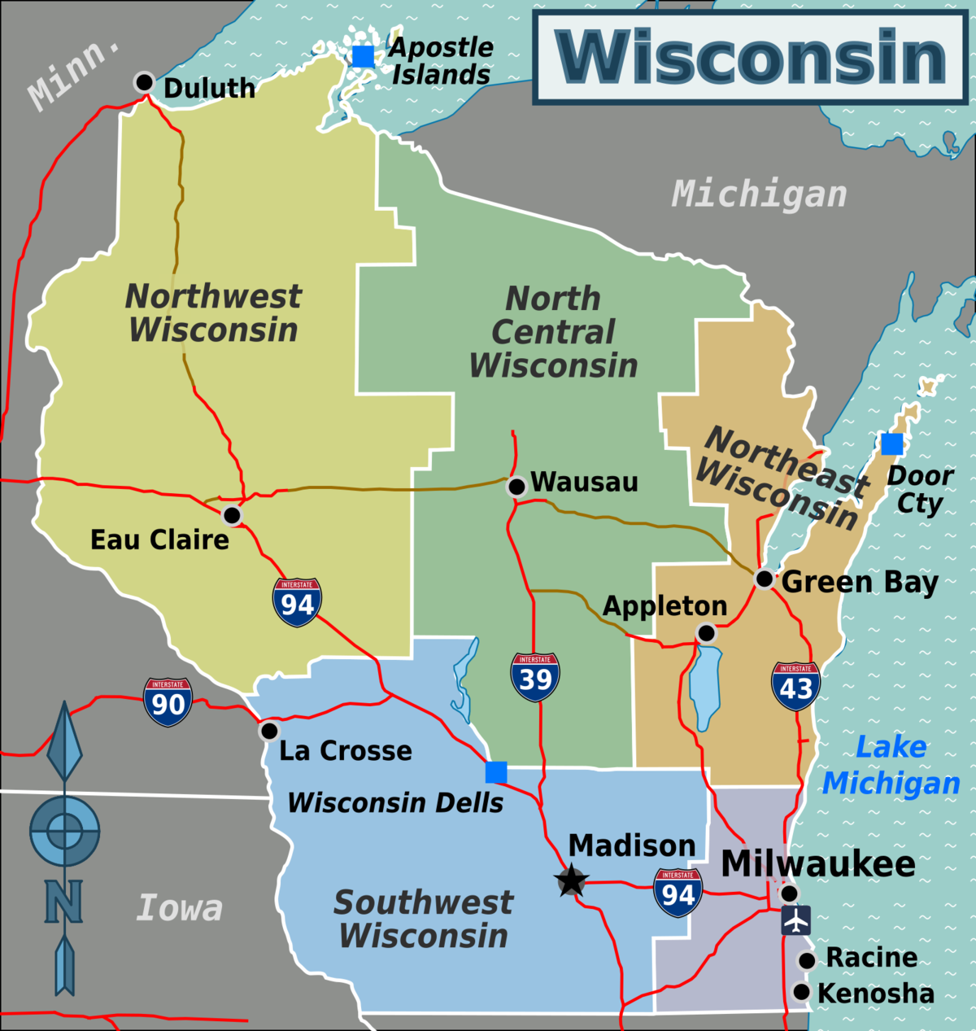
Congrats on your Success so far…
Good Luck this Year!
Contact me:
Jeff Morzinski PhD
jmorzins@mcw.edu

Slide 15
References
Bower D, Diehr S, Morzinski JA, Simpson D: Support, challenge, vision: A model for effective mentoring. Medical Teacher, 1998; 20(6):595-97.
Daloz L. Mentor: Guiding the journey of adult learners. San Francisco: Jossey-Bass. 1999.
Riley M, Skye E, Reed B. Mentorship in an academic department of family medicine. Family Medicine. 2014; 46(10): 792-6.
Kram KE. Mentoring at Work: Developmental Relationships in Organizational Life. Glenview, IL: Scott Foresman, 1985.
Morzinski JA, Fisher JC. A nation-wide study on the influence of faculty development programs on colleague relationships. Acad Med, 2002, 77(5).
Morzinski JA. Mentors, Colleagues, successful health science faculty: Lessons from the field. Journal of Veterinary Medical Education. 2005; 32(1), 5-12.
New Teacher Center @ USC. www.newteachercenter.org
Patterson K, Grenny J, McMillan R, Switzler A (2002). Crucial Conversations: Tools for Talking When the Stakes are High. New York: McGraw-Hill.
Wilson R. http://chronicle.com/article/New-Gender-Gap-in-Scholarship accessed 3/15/14

